Slide 1
Risk Storyboard

Slide 2
Title
Risk
Enter total number of players(2-6):
Start!

Slide 3
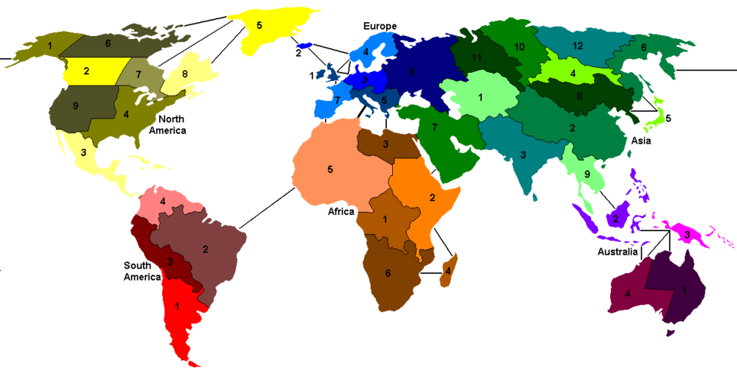
Player 1 Reinforce
Redeem Cards
Finalize Troops
Left-click to add
right click to remove
Number of troops to add: 6
Madagascar
Infantry
Greenland
Cavalry
End Turn

Slide 4
Player 1 Attack
Attack!
Left-click attacking territory
Right-click defending territory
You can only attack adjacent territories
Madagascar
Infantry
Greenland
Cavalry
End Turn

Slide 5
Player 1 Move
Fortify!
Left-click source territory
Right-click destination territory
You can only move through adjacent territories that you own
Madagascar
Infantry
Greenland
Cavalry
End Turn

Slide 6
Game over
Player 3 Wins!
Players | 1 | 2 | 3 | 4 | 5
Total Troops Owned
Troops Killed
Troops Lost
Territories Conquered
Territories Lost
New Game

Slide 7
References
http://upload.wikimedia.org/wikipedia/commons/thumb/a/aa/Risk_game_map_fixed.png/1000px-Risk_game_map_fixed.png

